Slide 1
NVG and ESS Lateral Range Curves, Sweep Width, and SAROPS
Art Allen
CG-SAR
Arthur.A.Allen@uscg.mil
4 June 2014

Slide 2
Search Object
SRU track
CPA
CPA = Closest Point of Approach
LR = Lateral Range (nm distance to CPA)
Search Object = what we are looking for
SRU = Search & Rescue Unit
4 hits
10 opportunities
(in this LR bin)

Slide 3


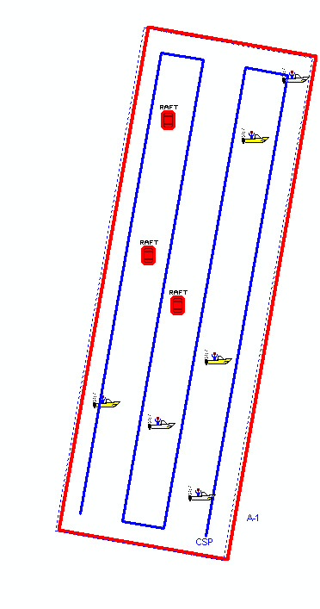
Analysis Methods - Determining Lateral Range Curves
SAR Targets Test Area
Mission-realistic test data
88/100
26/50
1/11

Slide 4
The POD at Lateral Range for a specific:
Platform / Sensor / Search Object / Environmental Conditions

Slide 5
Sweep Width is the integration of the area under the LRC

Slide 6

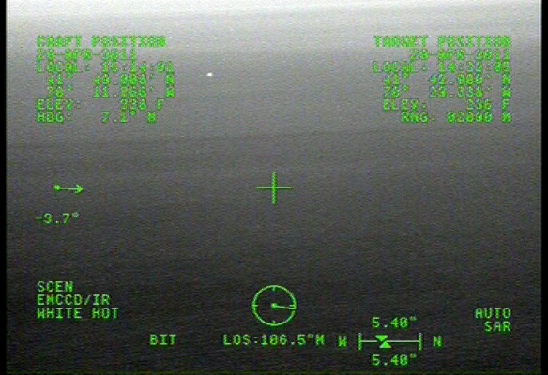
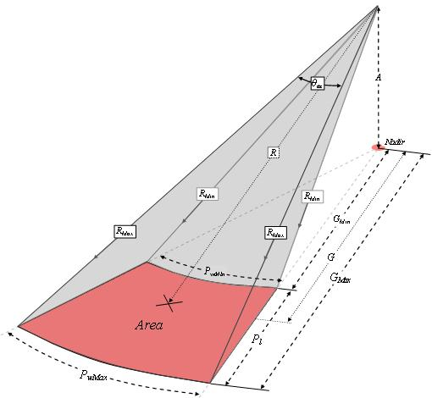
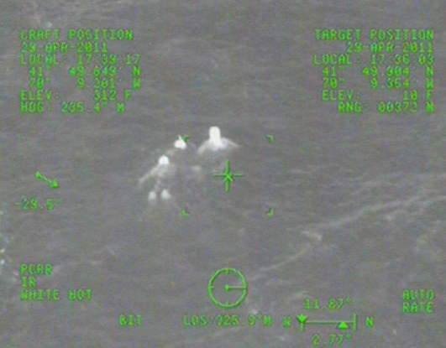
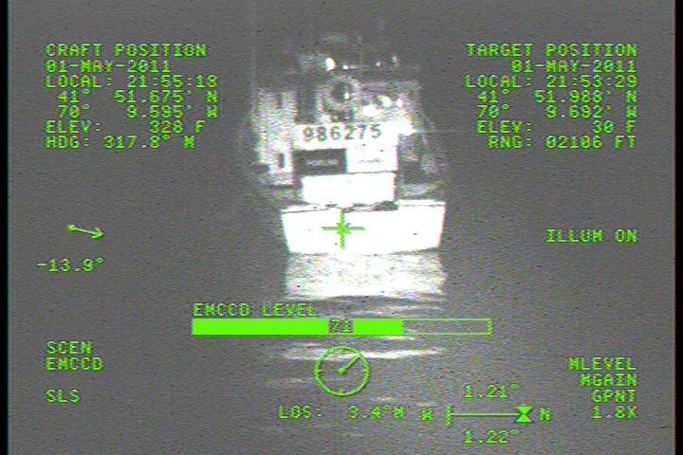
Electro-Optical Sensor System (ESS) HH-65 and HH-60 Field tests just completed
X X X X
Target Field

Slide 7
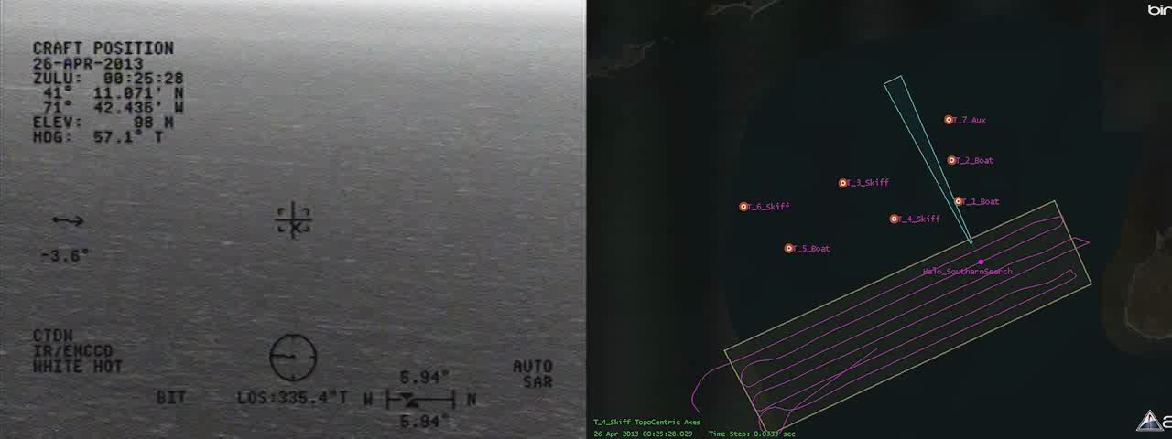

Slide 8
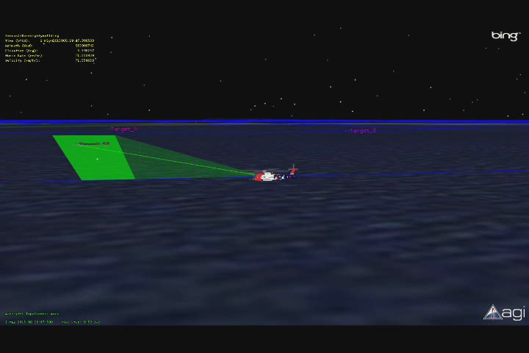

Slide 9
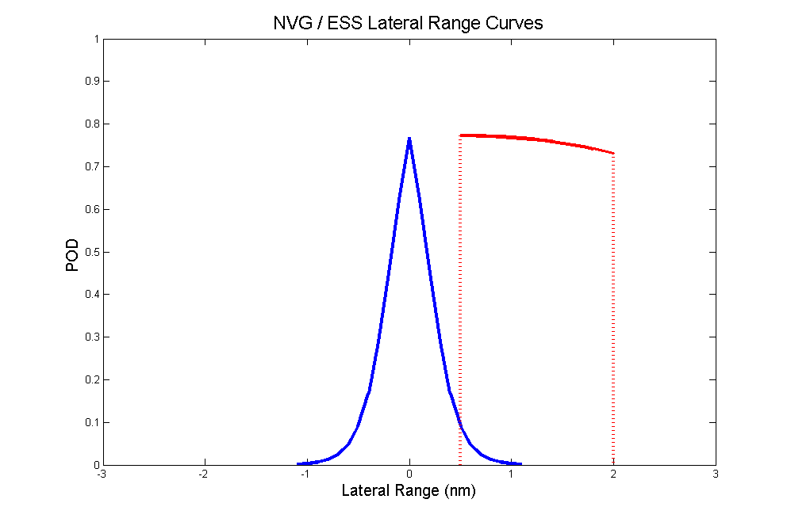
ESS LRC (One-sided, Creep orientated)
NVG LRC
(Symmetric,
Track orientated)
This Figure can now be replaced with ‘real’ NVG and ESS LRCs

Slide 10
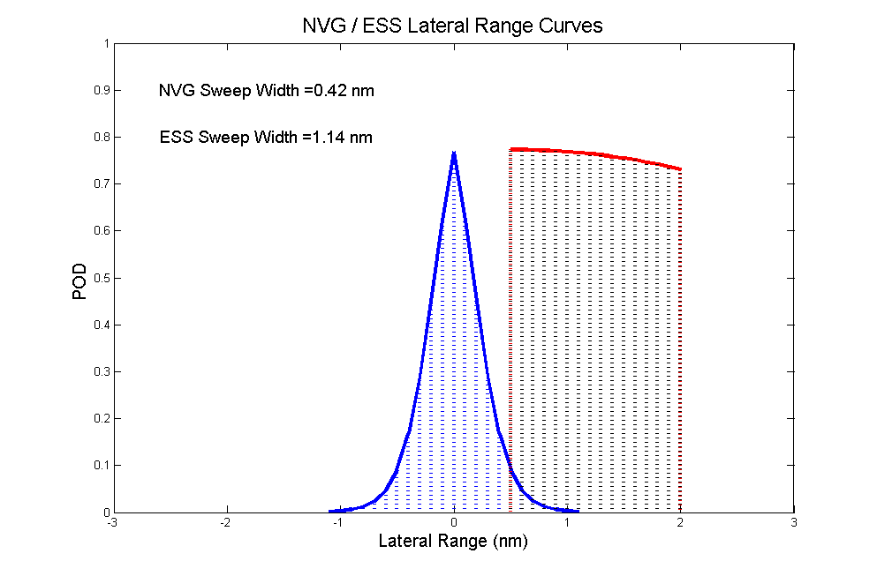
This Figure can now be replaced with ‘real’ NVG and ESS LRCs
Sweep Width is still the integration of the area under the LRC

Slide 11
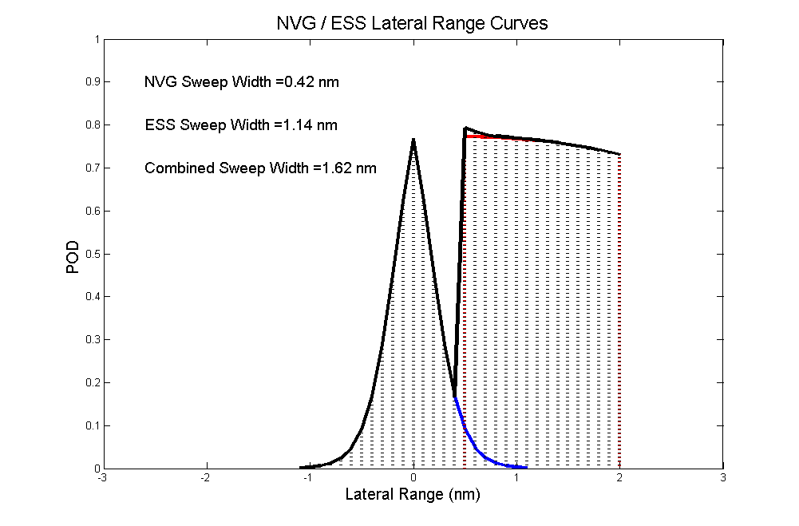
This Figure can now be replaced with ‘real’ NVG and ESS LRCs
Combining LRCs assuming 100% independence
LRC NVG ESS combined = 1 - (1 – LRC NVG x 1.0).*(1 – LRC ESS x 1.0);

Slide 12
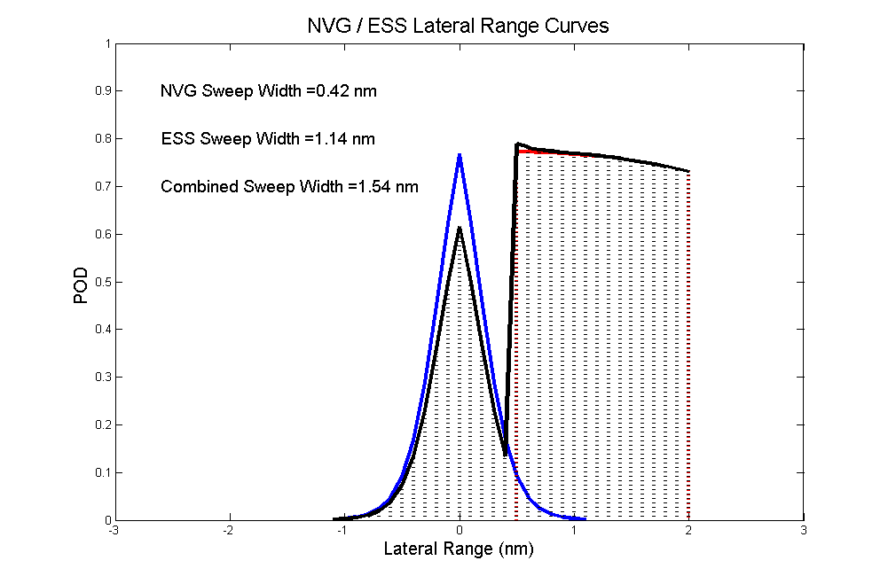
This Figure can now be replaced with ‘real’ 3 person NVG and ESS LRCs
Combining LRCs assuming 80% degradation of the NVG
LRC NVG ESS combined = 1 - (1 – LRC NVG x 0.8).*(1 – LRC ESS x 1.0);

Slide 13
ESS Field of View
Altitude (ft) | Mode | Dep. Angle (deg) | FOV Center (nmi) | Inner FOV (nmi) | Outer FOV (nmi)
300 | SAR-S | -3.39 | 0.83 | 0.52 | 2.07
300 | SAR-M | -2.8 | 1.01 | 0.58 | 3.65
300 | SAR-L | -2.44 | 1.16 | 0.63 | 6.82
500 | SAR-S | -4.3 | 1.09 | 0.74 | 2.07
500 | SAR-M | -3.31 | 1.42 | 0.88 | 3.67
500 | SAR-L | -2.71 | 1.74 | 0.99 | 6.88

Slide 14
So, what does this all mean for SAROPS?
SAROPS has 1000’s of particles; Each particle:
1) Represents a potential Search Object (L,H,W,RCS)
2) Has its own start time and location
3) Moves with its own leeway equation & currents
4) Has an Scenario Weight
5) Has an Search Object Weight
6) Starts with a P-Fail value of 1.0 (or 100%)

Slide 15
And, what does this mean for POS?
P-Fail = Probability of Failure to have yet been detected
POD = Probability of the SRU to detect the particle
LRC = POD as a function of Lateral Range
RRC = POD as function of Radial Range
POS = 1.0 - ∑ (P-fails) / # of particles

Slide 16
Now let’s return to our Visual LRC, and move it along a track line, passing over SAROPS particles.
As the Lateral Range Curve passes over a particle, the POD at CPA, updates the P-Fail value of that particle.

Slide 17
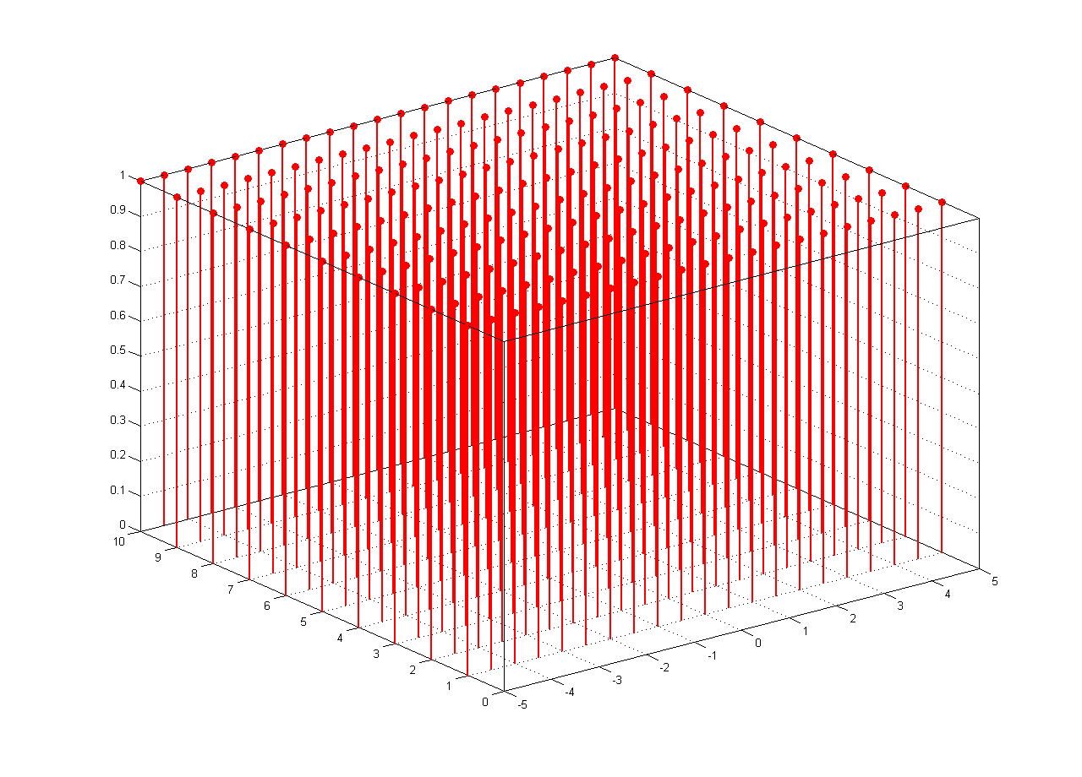
A Visual LRC moving along a trackline
Passing over uniformly distributed 200 Particles, updating their P-fail values that start at 100%
Along Track (nm)
Cross Track (nm)

Slide 18
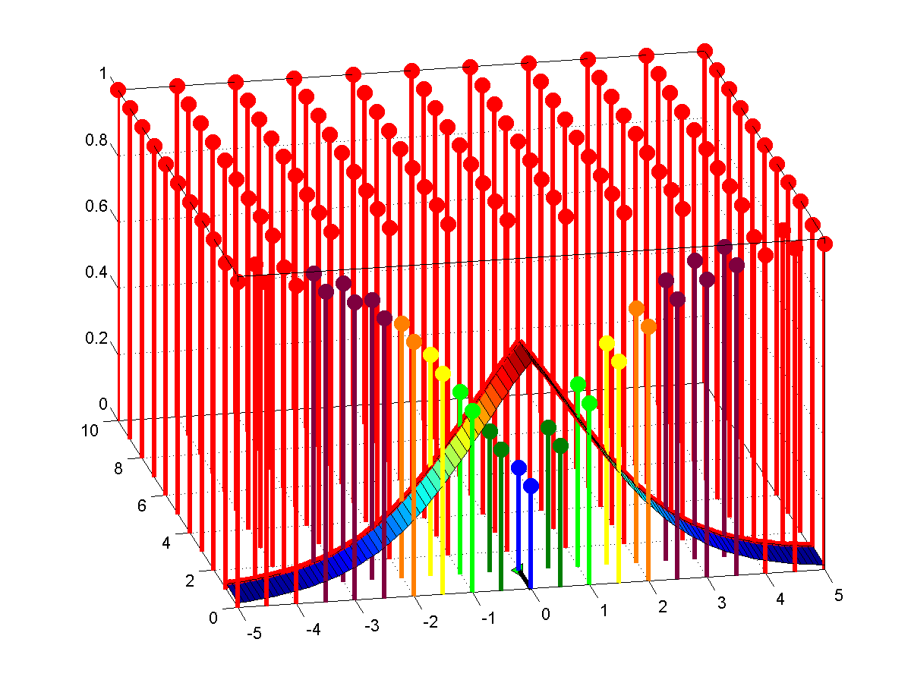
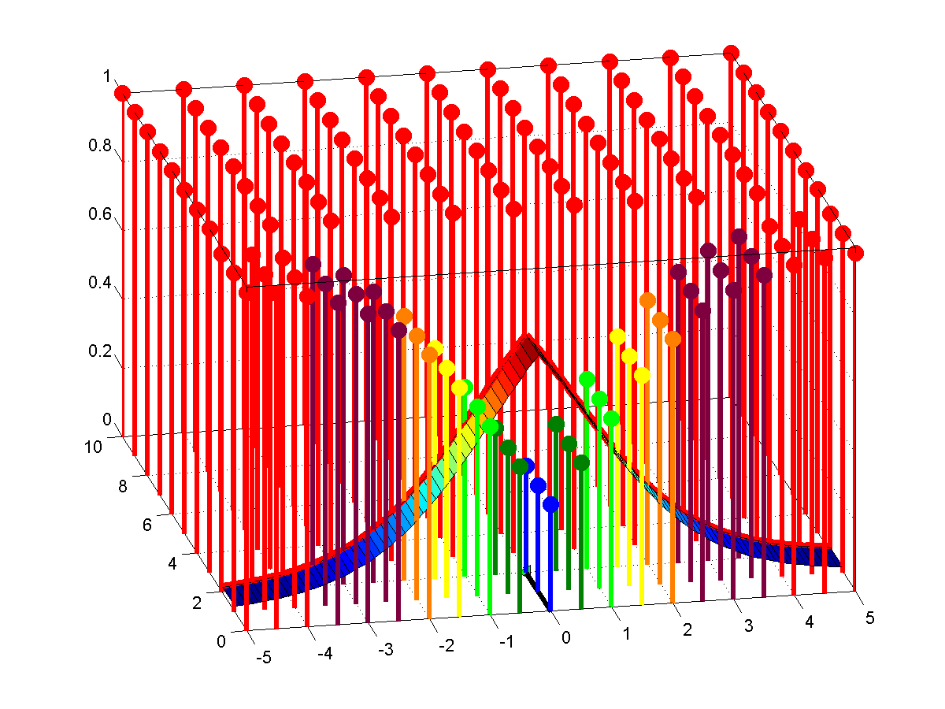
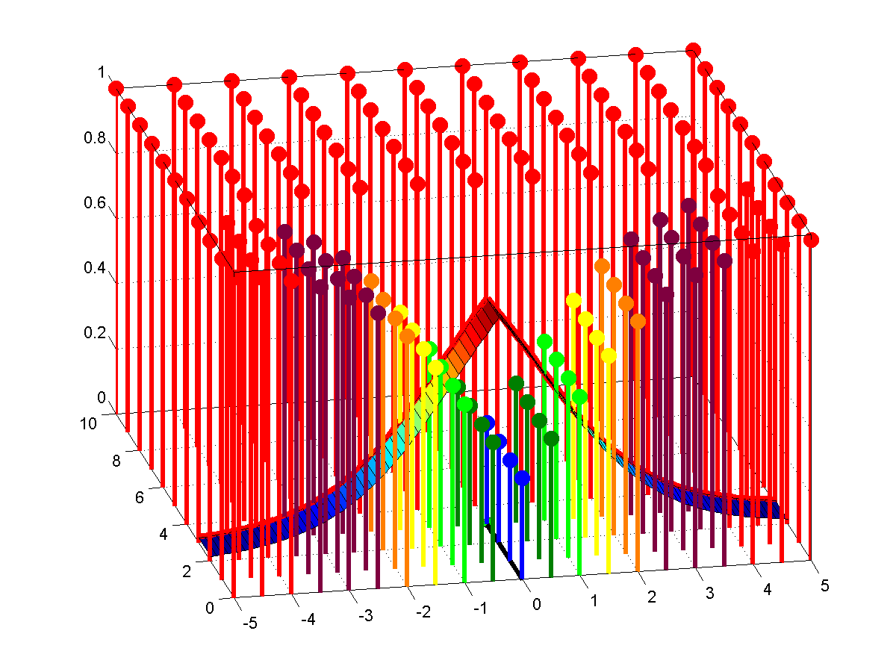

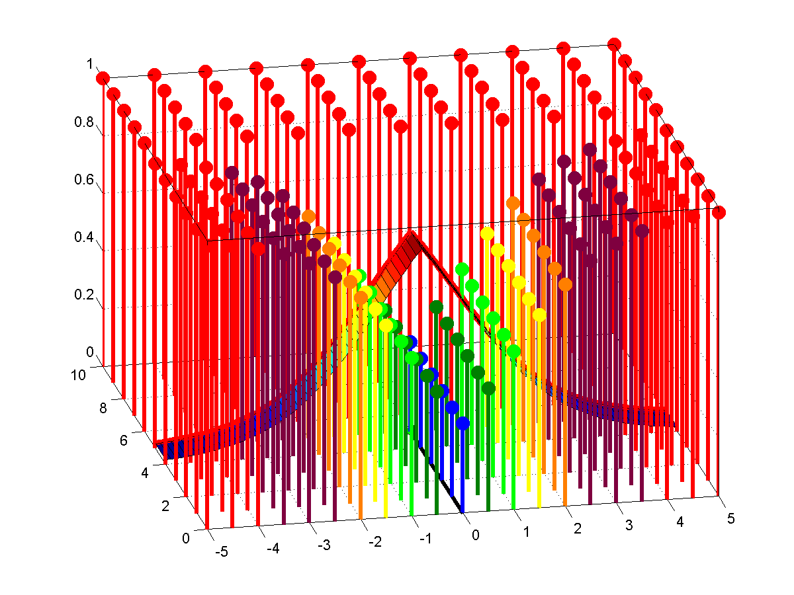
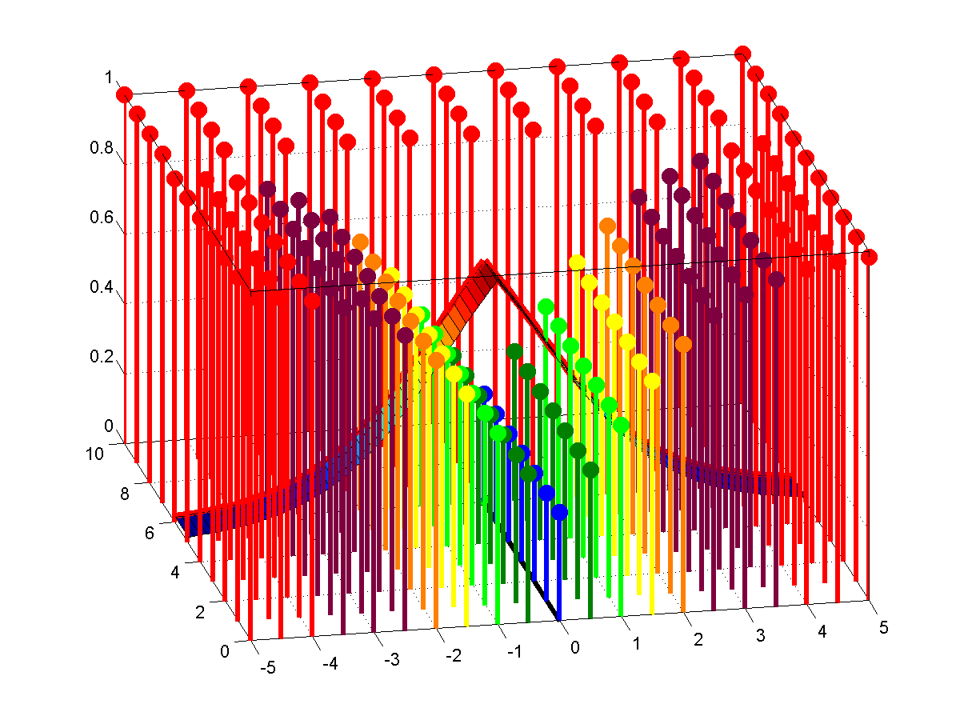
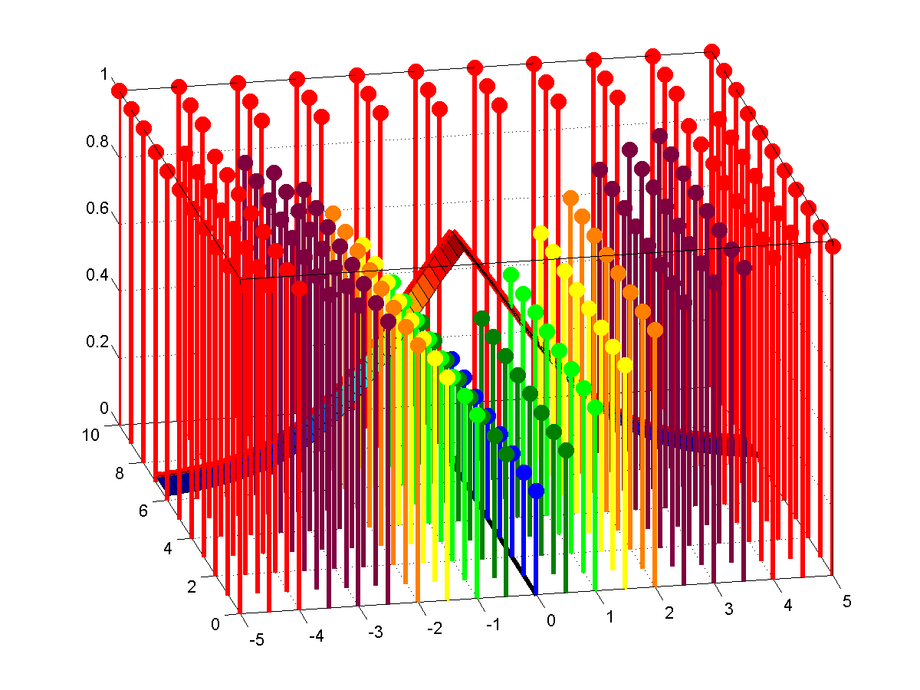
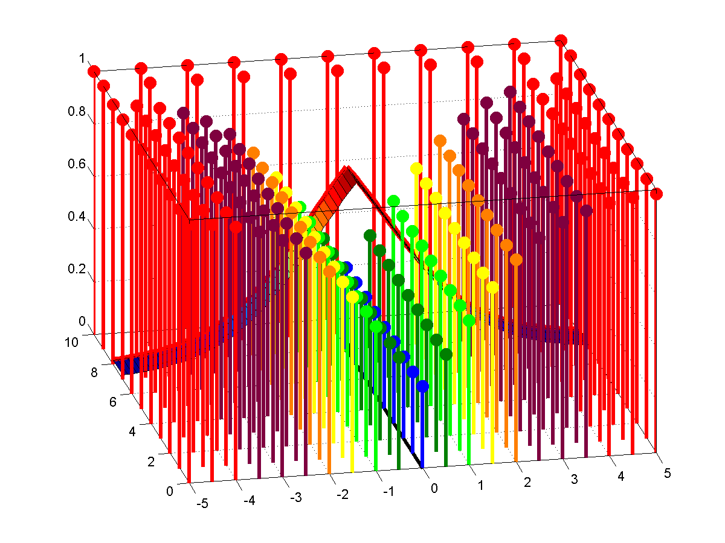
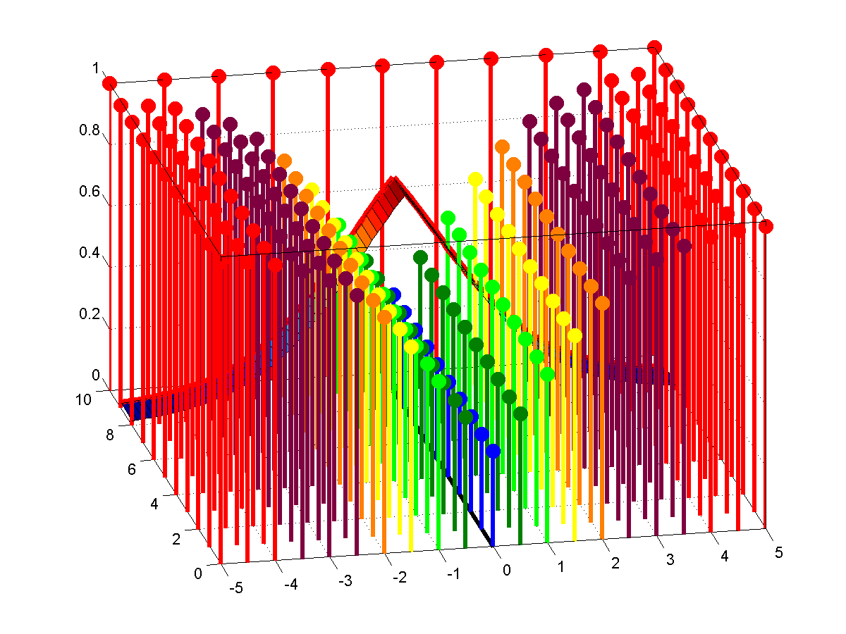
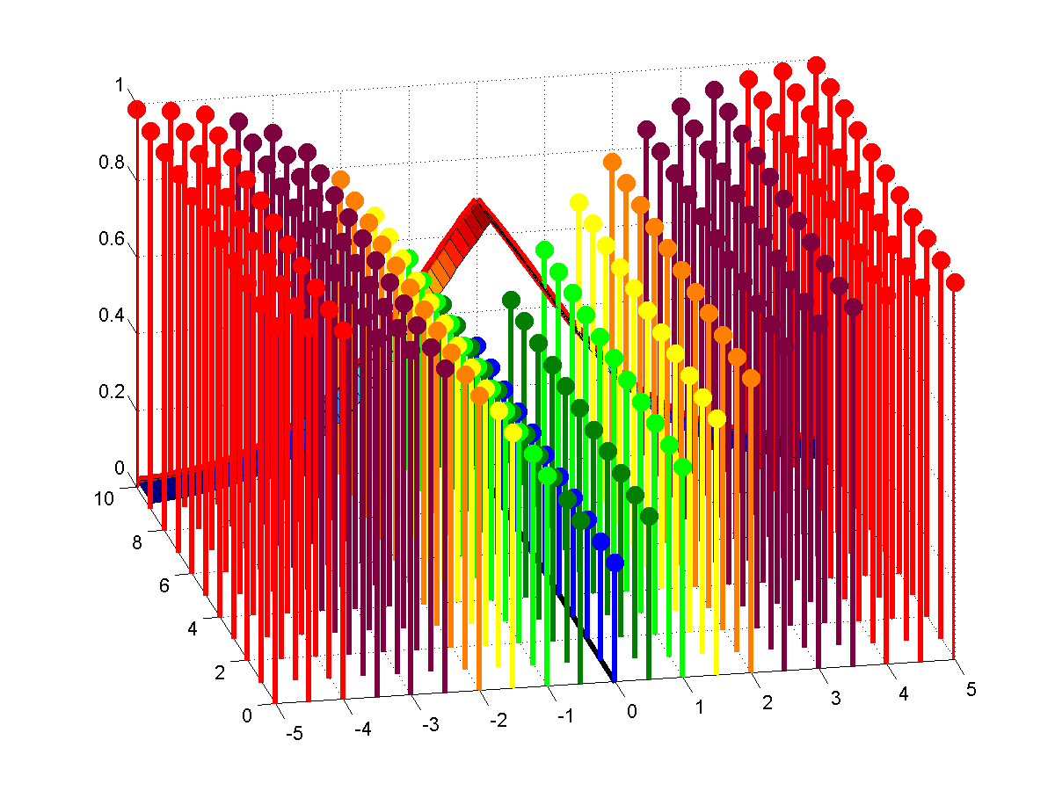
Visual LRC adjusting P-Fail values
P-Fail of particles, POD of LRC
Along Track (nm)
Cross Track (nm)

Slide 19
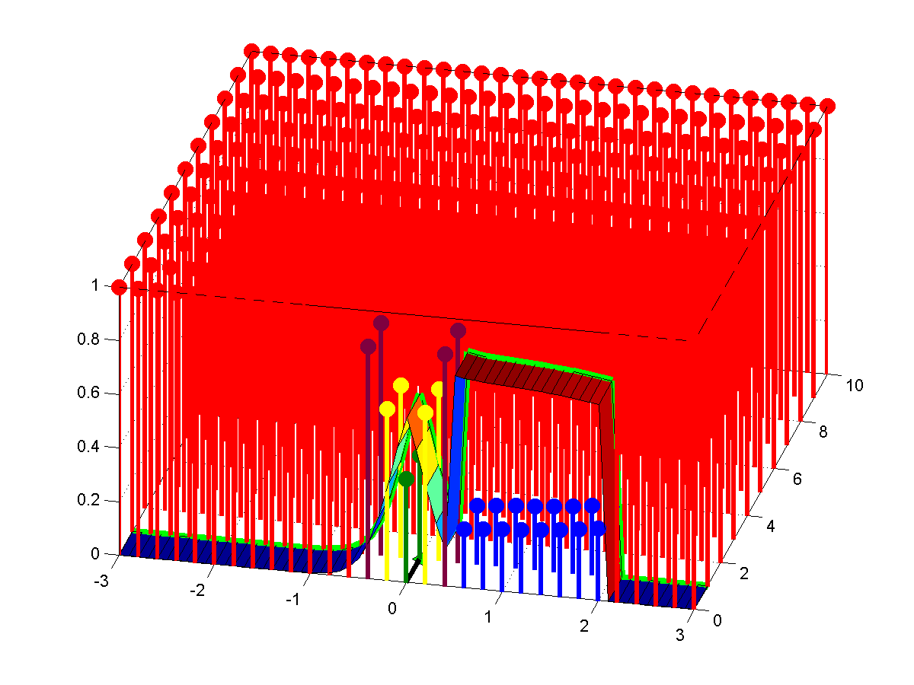
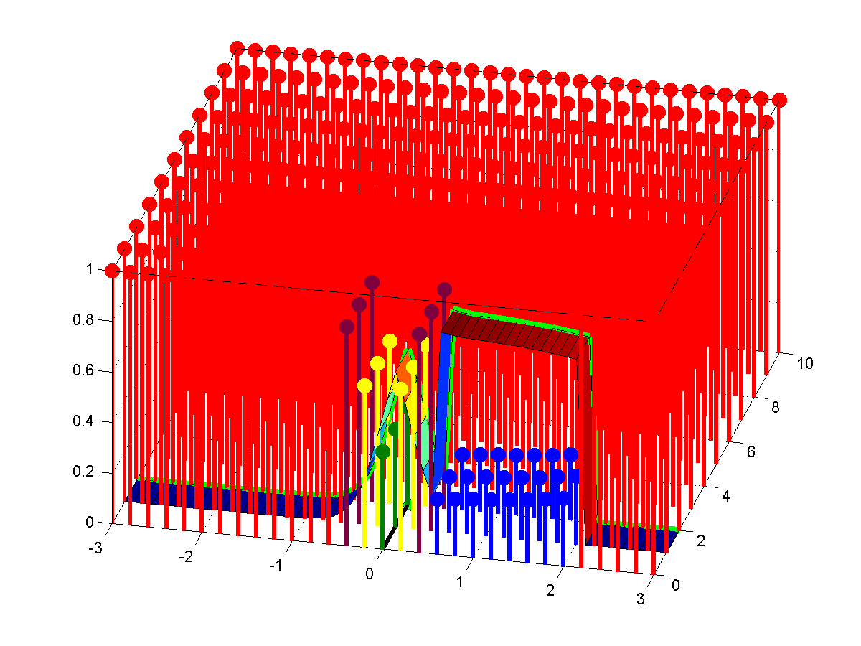
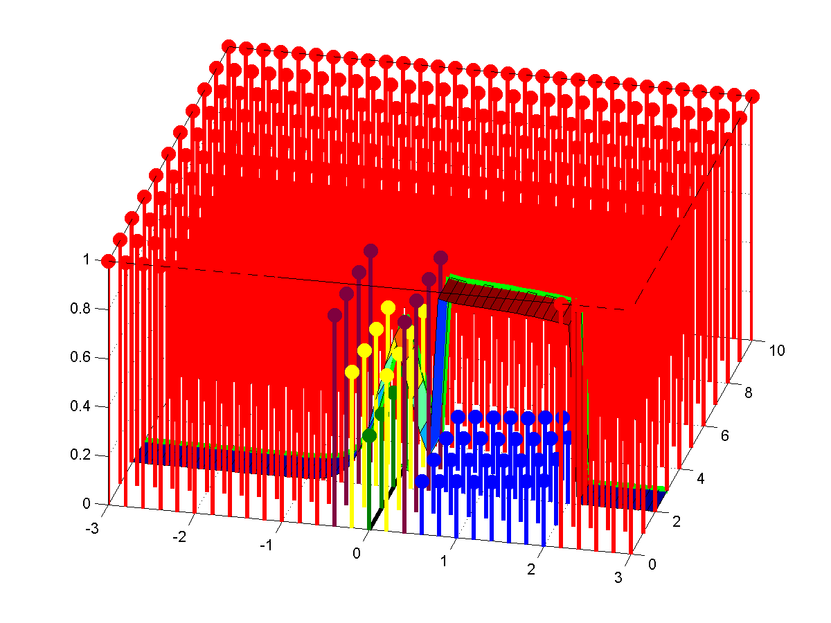
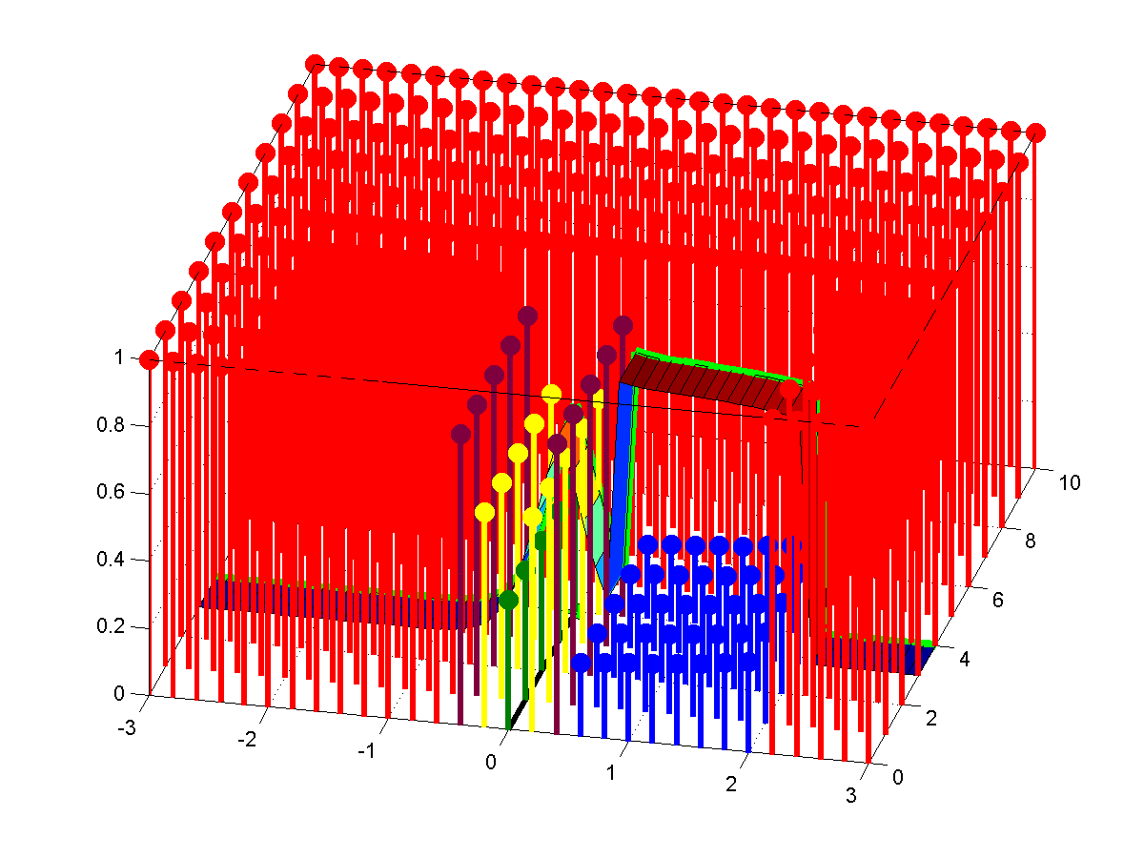

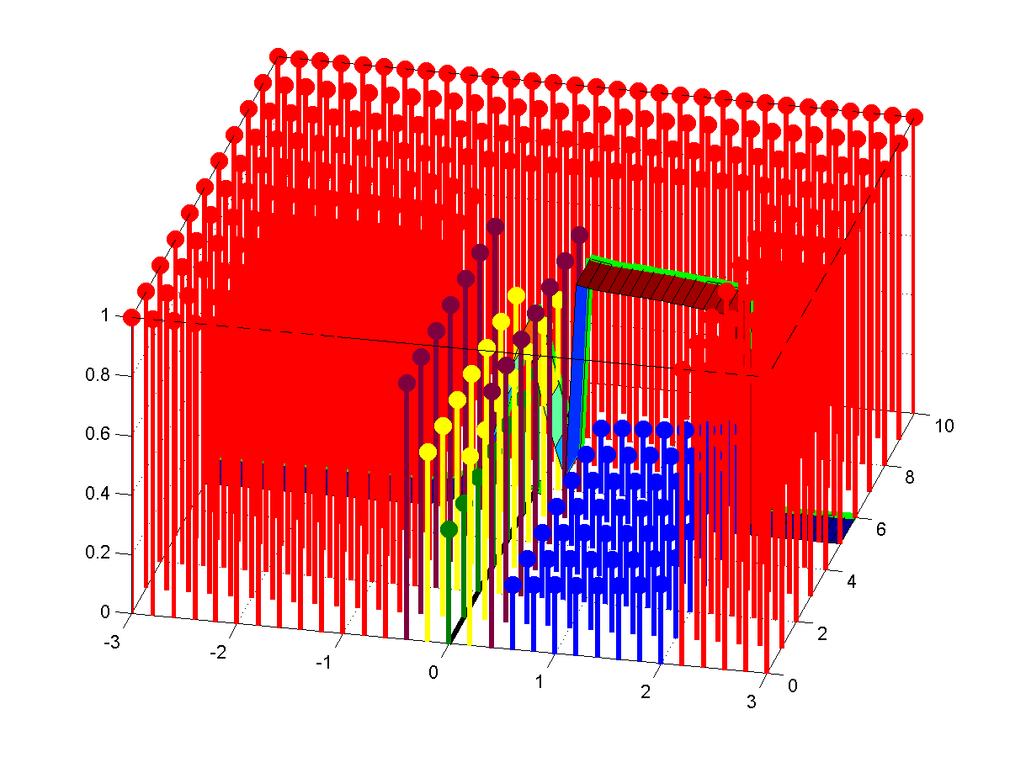
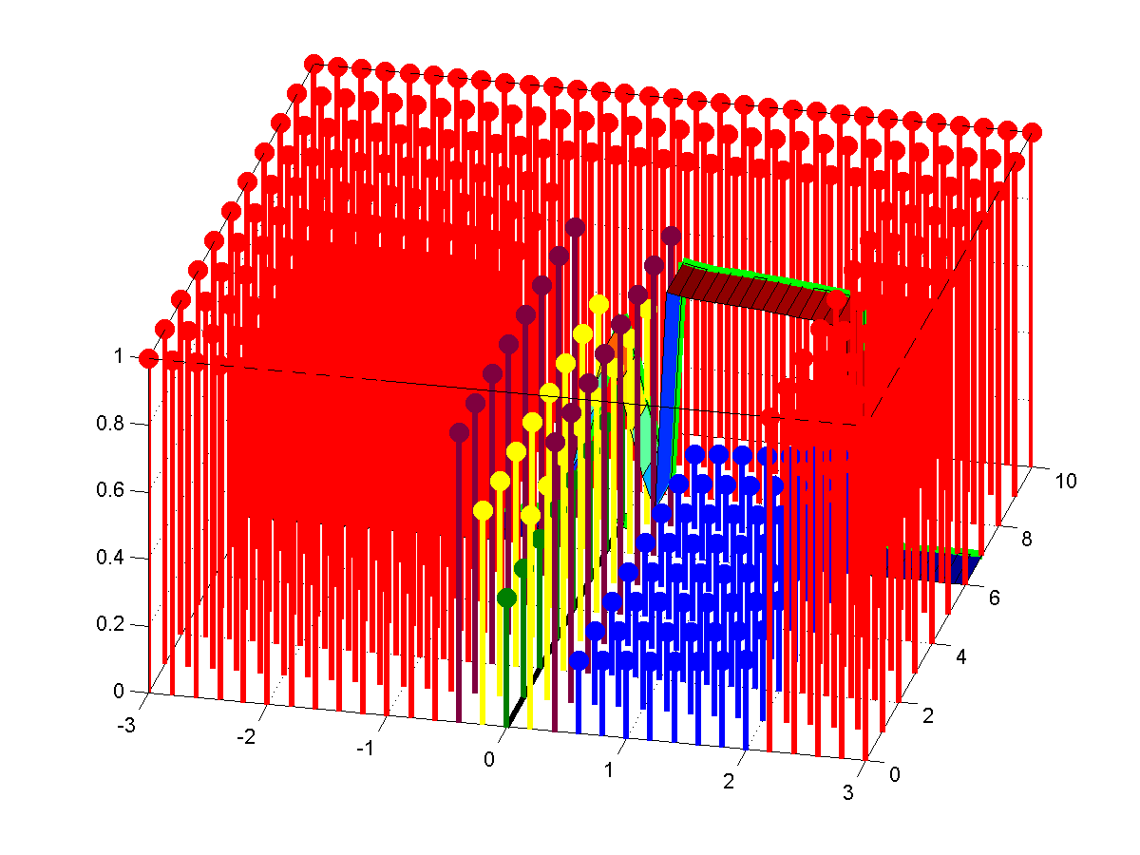
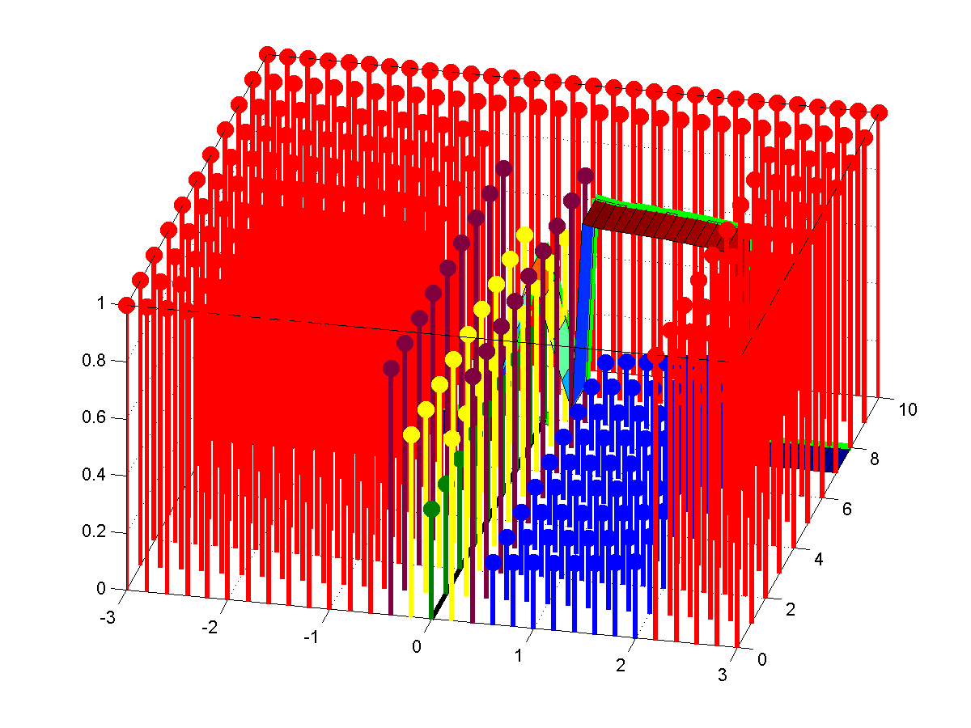
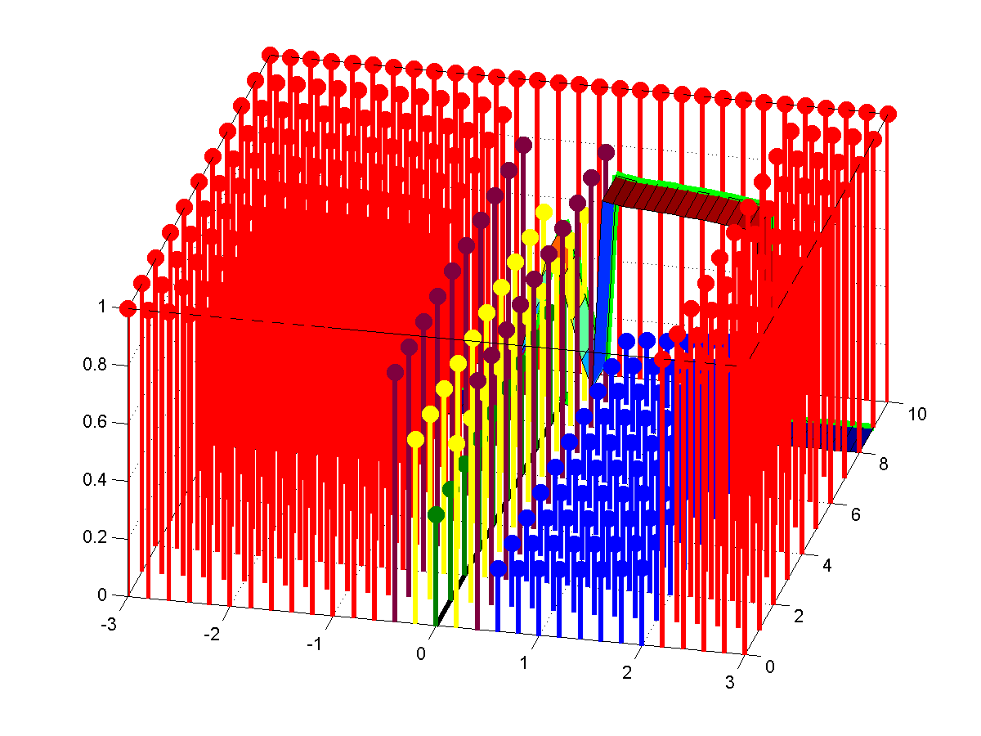
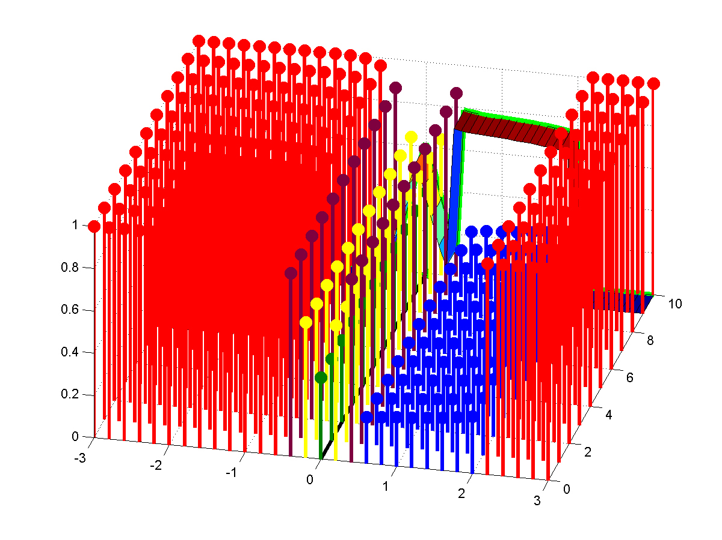
NVG and ESS combined LRC adjusting P-Fail values
P-Fail of particles, POD of LRC
Along Track (nm)
Cross Track (nm)

Slide 20
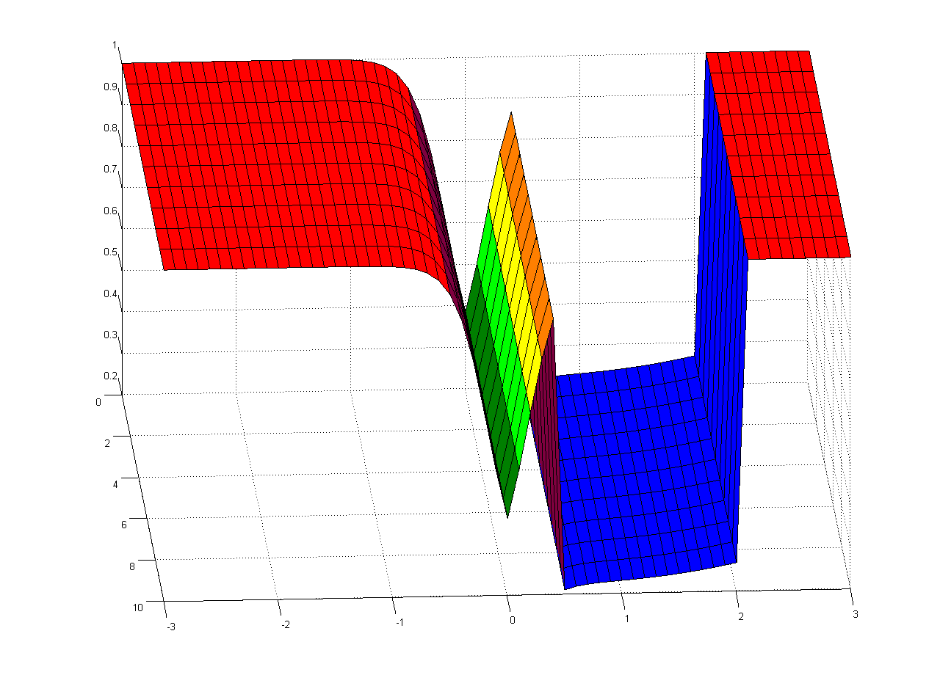
NVG and ESS combined LRC adjusted the Probability Density Distribution
∑(P-Fail of particles) # particles in grid
Along Track (nm)
Cross Track (nm)

Slide 21
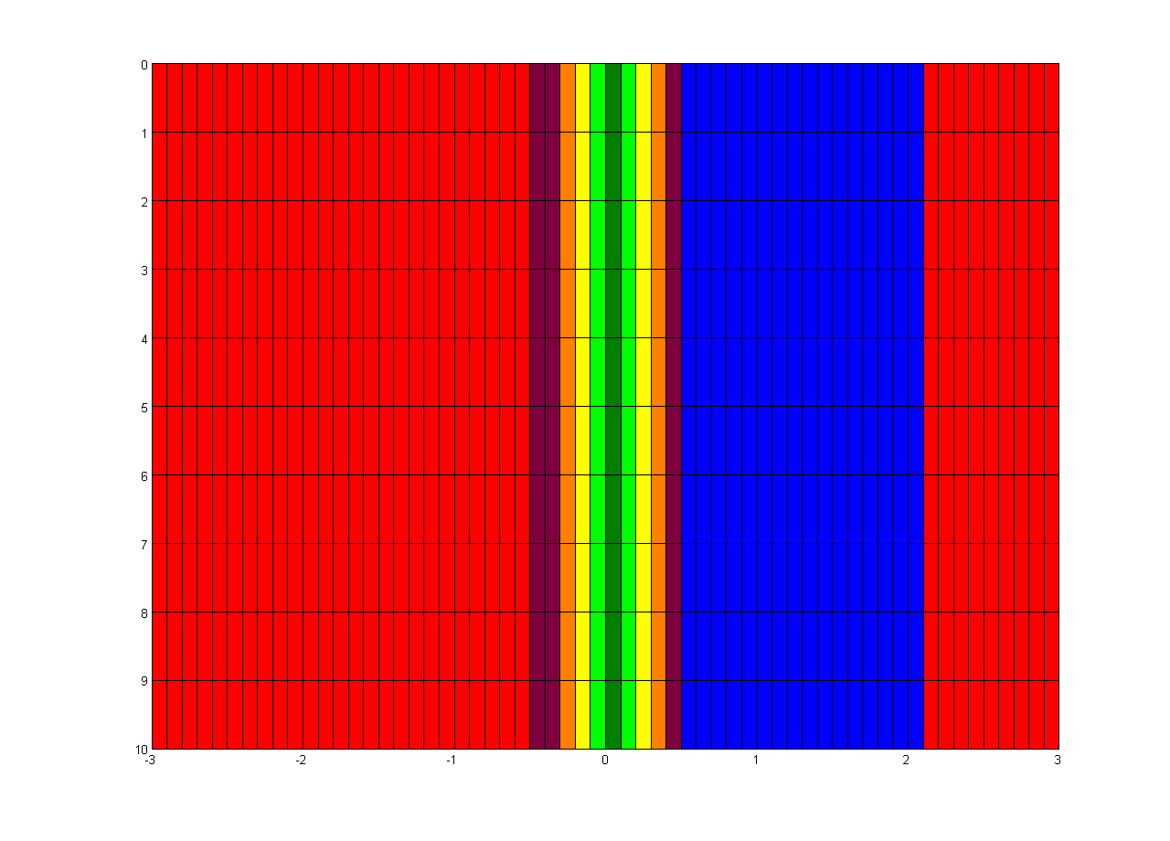
NVG and ESS combined LRC adjusted the SAROPS Probability Density Distribution
Along Track (nm)
Cross Track (nm)

Slide 22
And, what does this mean for POS?
An 3 Particle SAROPS Example:
Particles starts with P-fail of 100% (POS = 0%)
LRC passes over particles with POD at Particle’s CPA (POD of 20%, 60% & 40%)
P-Fail of 1st particle is now 1.0 -0.20 = 0.80 (80%)
P-Fails of our 3 particle SAROPS run are now:
P-Fails = 0.8, 0.4, 0.6
POS = 1.0 - ∑ (P-fails) / # of particles
POS = 1.0 - (0.8 + 0.4 + 0.6) /3 = 1.0 – (1.8/3) = 1.0 - 0.6
POS = 0.40 or 40%

Slide 23
How would the GUIs look in SAROPS? What information is passed in SAROPS?
SAROPS 1.4 GUIs for Selecting Platform / Sensors
SAROPS 1.4 XML for passing LRCs to SIM
SAROPS 2.0 GUIs for Selecting Platform / Sensors
SAROPS 2.0 XML for passing LRCs to SIM
SAROPS 2.1 GUIs for Selecting Platform / Sensors
SAROPS 2.1 XML for passing LRCs to SIM
GUI = a Graphical User Interface page

Slide 24
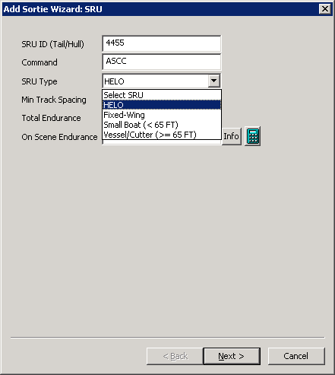
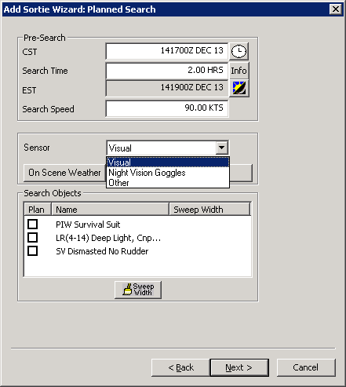
SAROPS Version 1.5
1) Select Platform
2) Select one Sensor

Slide 25
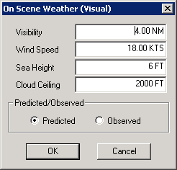
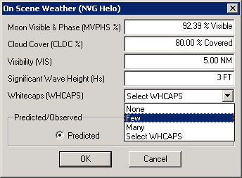
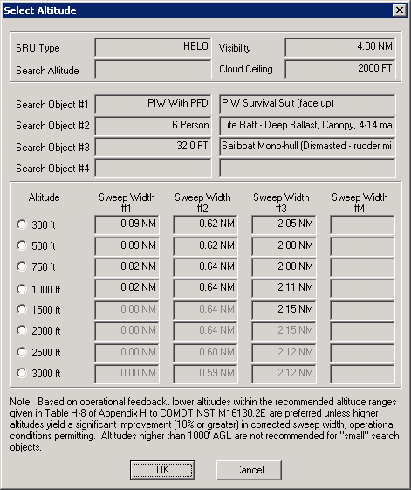
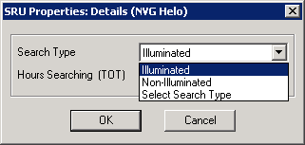
3) Select Sensor’s Details
4) NVG Details
4) Visual Details
Or

Slide 26
SAROPS Version 1.5 XML examples
Visual Search
<COMP_OBJECT_TYPE id="1" sw="0.62 NM" ap0="-1.304359" a1="-0.779469" isActive="yes" />
NVG Search
<COMP_OBJECT_TYPE id="1" sw="0.62" ap0="-1.304359" a1="-0.779469" isActive="yes" actualID="2" otherXML="" />
Ideal Other Search
<COMP_OBJECT_TYPE id="1" sw="1" ap0="3" a1="-6.097175" isActive="yes" actualID="0" otherXML="" />
Normal Other Search
<COMP_OBJECT_TYPE id="1" sw="0.5" ap0="0" a1="-2.772589" isActive="yes" actualID="0" otherXML="" />
M Beta Search
<COMP_OBJECT_TYPE id="1" mOfMBeta="140 M" betaOfMBeta="0.7" />

Slide 27
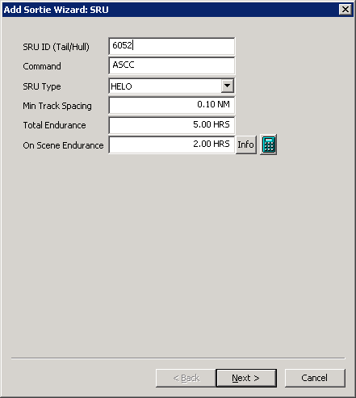
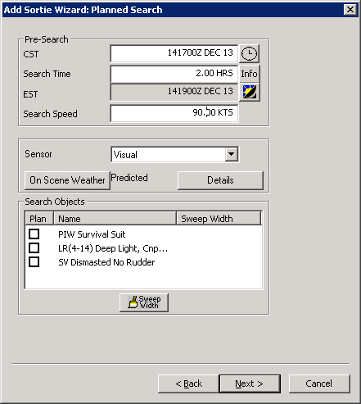
SAROPS Version 2.0
1) Select Platform
2) Select one Sensor
Select SRU
Helo
Fixed Wing
HC-130J
HC-130H
HC-144A
Vessel
Visual
NVG
Airborne radar
Other

Slide 28
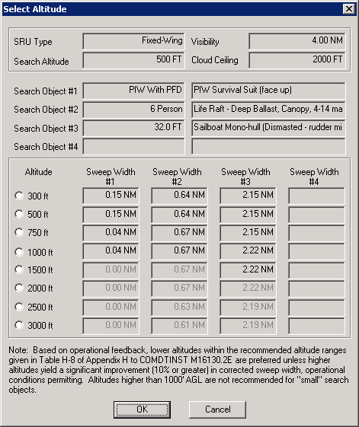
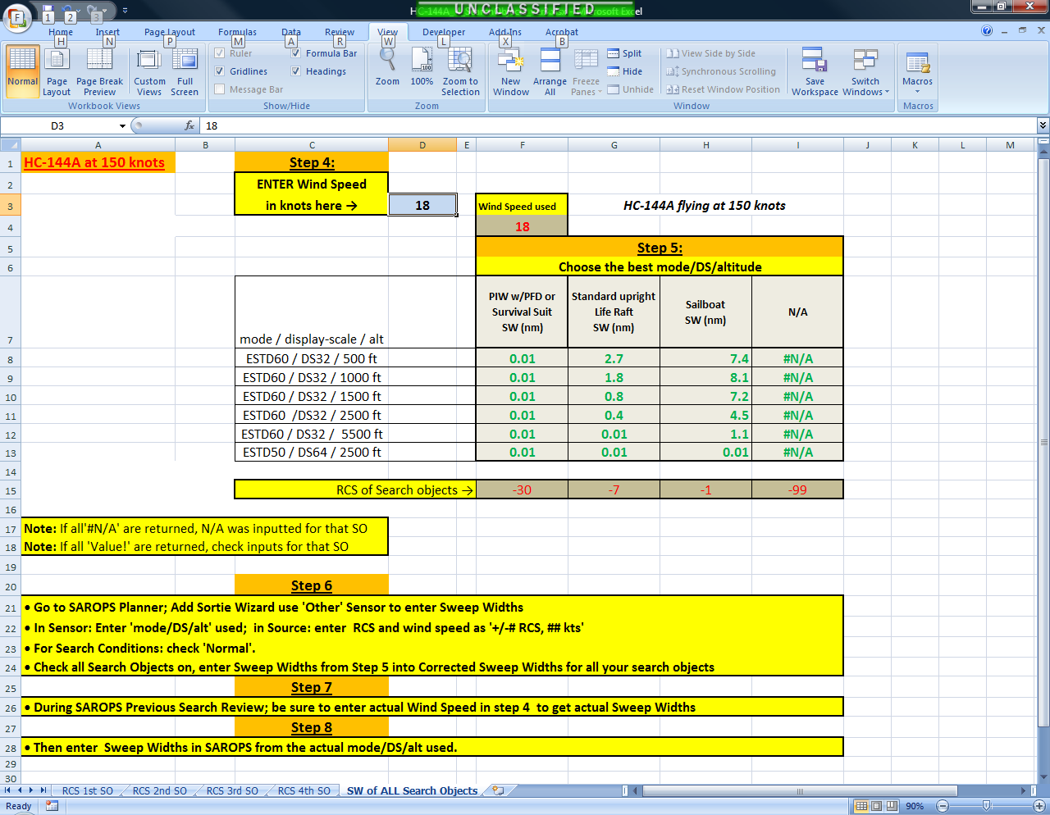
SAROPS Version 2.0
3) Select Radar’s Details
Select Mode /Display Scale / Altitude combination
Wind Speed
18 knots

Slide 29
SAROPS Version 2.0 XML examples
Visual / NVG Search (Symmetrical)
<LRC_TYPE LR_Type=“Symmetric” LowerLimit= “-100 NM” UpperLimit= “100nm” Orientation=“Platform” PFactor=“1.0” ApplyPFactor=“Full” />
<COMP_OBJECT_TYPE id="1" sw="0.62 NM" ap0="-1.304359" a1="-0.779469“ a2=“0.0" isActive="yes" />
<COMP_OBJECT_TYPE id=“2" sw=“1.62 NM" ap0=“1.4500" a1="-0.779469“ a2=“0.0" isActive="yes“ />
Radar
<LRC_TYPE LR_Type=“Symmetric” LowerLimit= “-30 NM” UpperLimit= “30nm” Orientation=“Platform” PFactor=“1.0” ApplyPFactor=“Full” />
<COMP_OBJECT_TYPE id="1" sw=“23.4 NM" ap0=" 1.7507 " a1=" 0.0865“ a2=“-0.0171 " isActive="yes" />
<COMP_OBJECT_TYPE id=“2" sw=“21.9 NM" ap0=“1.0449 " a1=" 0.1456 “ a2=“-0.0179 " isActive="yes“ />
Note) One LRC per Search Object

Slide 30
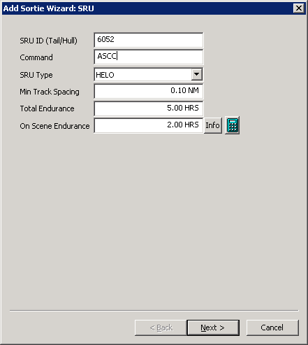

SAROPS Version 2.1
1) Select Platform
2) Check all Sensors that apply
Select SRU
Helo
Fixed Wing
HC-130J
HC-130H
HC-144A
Vessel
Visual
☑ NVG
Airborne radar
☑ ESS
Other

Slide 31
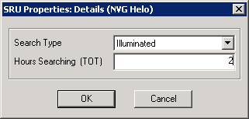
3) Select ESS’s / NVG Details
4) ESS & NVG On Scene Details
6) NVG additional inputs
(full slant range Logit model)
On Scene Weather (ESS Helo)
Wind Speed (kts)
10
Searchers on NVGs
3/4
5) ESS Mode Air Speed / Altitude Details
SAR Small @ 70 kts
SAR Medium @90 kts
SAR Large @ 90kts
Down Creep Orientation
Up Creep Orientation
Boat Length (Ft)
have
☑ 300 ft altitude
500 ft altitude
Air- Temp(ºF/ºC)
Water Temp (ºF/ºC)
new
new
Speed back fills

Slide 32
SAROPS Version 2.1
1) Select Platform
2) Check all Sensors that apply
Select SRU
Helo
Fixed Wing
HC-130J
HC-130H
HC-144A
Vessel
Search Speed
Visual
☑ NVG
Airborne radar
☑ ESS
Other

Slide 33
SAROPS Version 2.1 XML examples
ESS
<LRC_TYPE LR_Type=“DownCreep” LowerLimit= “0.52 NM” UpperLimit= “2.07 NM” ApplyCrossLegs = “False”/>
<COMP_OBJECT_TYPE id="1" ap0=" 1.2507 " a1=" 0.0865“ a2=“-0.102 " isActive="yes" />
<COMP_OBJECT_TYPE id=“2" ap0=“1.0469 " a1=" 0.1456 “ a2=“-0.134 " isActive="yes“ />
ESS combined with NVG
<LRC_TYPE LR_Type=“DownCreep” LowerLimit= “0.52 NM” UpperLimit= “2.07 NM” ApplyCrossLegs = “False”/> />
<COMP_OBJECT_TYPE id="1" ap0=" 1.2507 " a1=" 0.0865“ a2=“-0.102 " isActive="yes" />
<COMP_OBJECT_TYPE id=“2" ap0=“1.0469 " a1=" 0.1456 “ a2=“-0.134 " isActive="yes“ />
<LRC_TYPE LR_Type=“RightPlatform” LowerLimit= “-10 NM” UpperLimit= “10 NM” ApplyCrossLegs = “True”/> />
<COMP_OBJECT_TYPE id="1" ap0="-1.304359" a1="-0.779469“ a2=“0.0" isActive="yes" />
<COMP_OBJECT_TYPE id=“2" ap0=“1.4500" a1="-0.779469“ a2=“0.0" isActive="yes“ />
<LRC_TYPE LR_Type=“LeftPlatform” LowerLimit= “-10 NM” UpperLimit= “10 NM” ApplyCrossLegs = “True”/> />
<COMP_OBJECT_TYPE id="1" ap0="-1.304359" a1="-1.579469“ a2=“0.0" isActive="yes" />
<COMP_OBJECT_TYPE id=“2" ap0=“1.4500" a1="-1.69469“ a2=“0.0" isActive="yes“ />

Slide 34
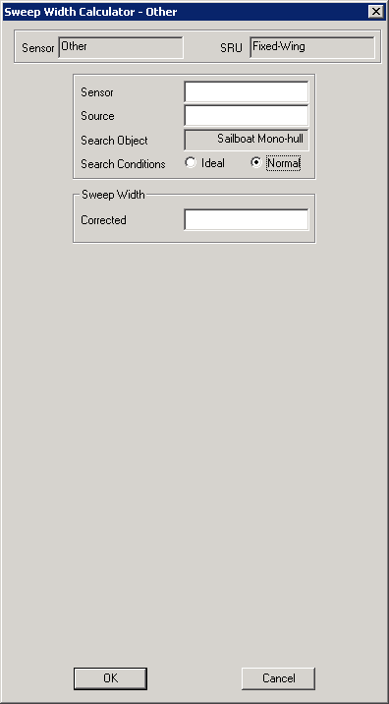
SAROPS Version 1.5 Other Sensor GUI inputs and selections

Slide 35
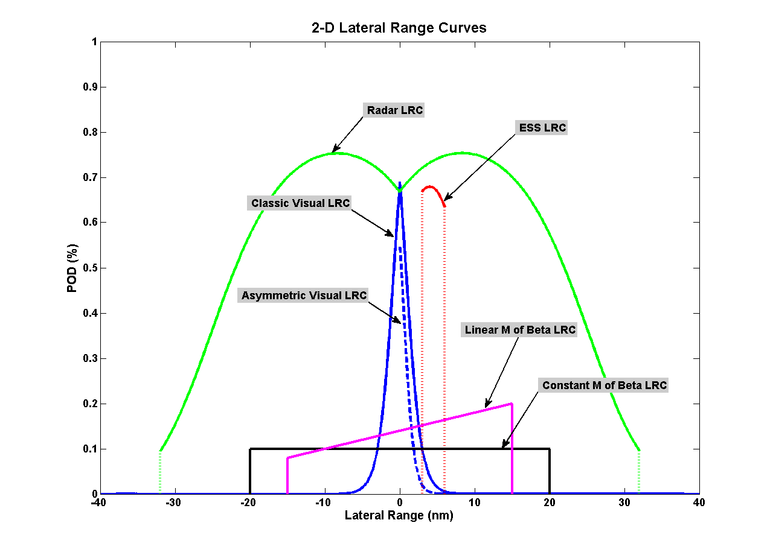
SAROPS Version 2.1 Other Sensor GUI inputs and selections
Input Fields: (Choices)
Per Sensor:
LRC_TYPE: ‘Symmetrical’, “Nonsymmetrical”, ”MBeta”, “Double MBeta, “Radial”
Orientation: “Platform”, ”DownCreep”, ”UpCreep”, “DoubleLook”, ”Static”
Lower limit: _____ “NM”, ”M”, ”KM”, ”Deg”
Upper limit: _____ “NM”, ”M”, ”KM”, ”Deg”
Performance Factor: _____ (2.0 to 0.0)
Apply Performance Factor: “Full”, ”Left”, ”Right”,
Per Search Object:
Sweep Width: _____ “NM”, ”M”, ”KM”
POD Constant: _____
POD Slope: _____
POD 2nd Order Term: _____

Slide 36
SAROPS Version 2.1
Other Sensor GUI inputs and selections
LRC Type
☑ Symmetrical
Nonsymmetrical
M Beta
Double M Beta
Radial
LRC Orientation
☑ Platform
Down Creep
Up Creep
Double-look
Static
Lower Limit
☑ Nautical Mile
Km
Meter
Statute Mile
Feet
Degrees True
Upper Limit
Performance Factor
1.0
(0.0 to 2.0)
Apply Performance Factor
☑ Full
Left
Right
Constant Term
Slope Term
2nd Order Term

Slide 37
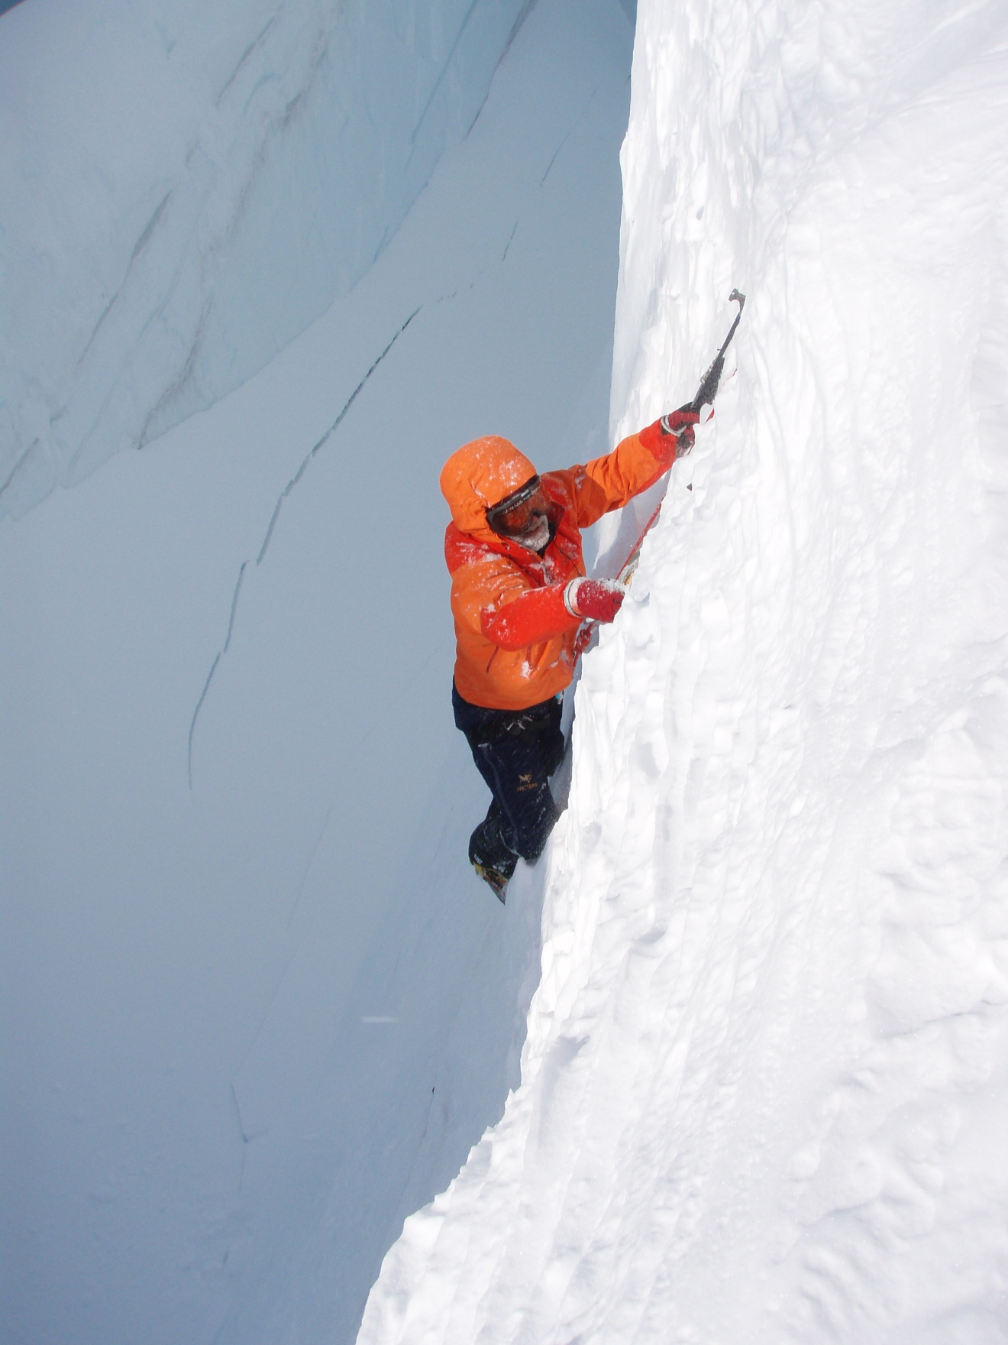
Questions?
Art Allen
CG-SAR
Arthur.A.Allen@uscg.mil
6 May 2014

